Slide 1
Phishing Awareness & Prevention Training
Presenter: Zain Bashir
STUDENT ID: CA/DF1/32837

Slide 2

What is Phishing?
Definition: Phishing refers to email messages, websites, and phone calls designed to steal money or sensitive information.
How it Works: Cybercriminals install malicious software, trick you into giving up data, or steal personal info directly from your computer.

Slide 3
Types of Attacks & Social Engineering
Social Engineering: Attackers use your public profiles (Facebook/LinkedIn) to find your name,
birth date, workplace, and interests to make messages look legitimate.
Spear Phishing: Attacks directed at specific individuals or companies. This is the most successful technique,
accounting for 91% of internet attacks.
Clone Phishing: A legitimate, previously delivered email is copied, but its attachment or link is replaced with a
malicious version.
Voice Phishing (Vishing): Criminals use telephone systems to gain financial info, often targeting credit
card numbers.

Slide 4
Real-World Example 1 Spear Phishing (VSU Password)
Key Red Flags to Identify:
Sender Check: Ask if you know the person or are expecting the email.
Hidden Recipients: Large-scale phishing often blanks out the "To:" or "Cc:" fields to hide that it is a mass email.
Urgent Subject: Look for all caps or multiple exclamation marks (e.g., "ADMINISTRATOR") to create a false sense of importance.
The "Hover" Test: Hovering over the link "Click Here" reveals it leads to an external site (wc.lt) instead of a valid university address.

Slide 5
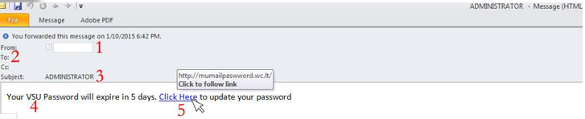
Real-World Example 1 Spear Phishing (VSU Password)

Slide 6
Real-World Example 2 Account Upgrade Scams
Key Red Flags to Identify:
Mismatched Domains: The sender claims to be "Service" but uses a @ucla.edu address while talking about a Valdosta upgrade.
External Links: The upgrade link points to jimdo.com, which is not part of the official university domain.

Slide 7
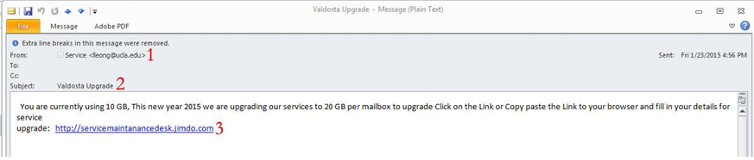
Real-World Example 2 Account Upgrade Scams

Slide 8
Real-World Example 3 — PayPal & eBay Scams
Key Red Flags to Identify:
Generic Sender: Legitimate eBay emails show the specific buyer/seller username; phishing uses generic addresses like member@ebay.com.
Spelling/Grammar: Look for errors like "The payment have been made" or "your aceeunt".
Fake Contact Emails: Official PayPal emails will always end in @paypal.com, never something like @mail2world.com.

Slide 9
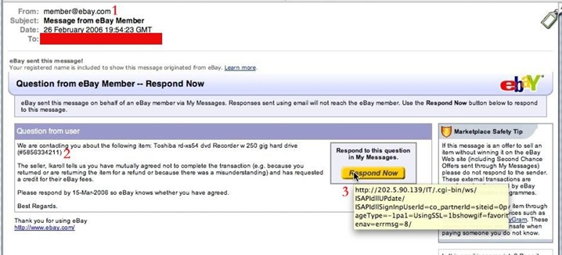
Real-World Example 3 — PayPal & eBay Scams

Slide 10
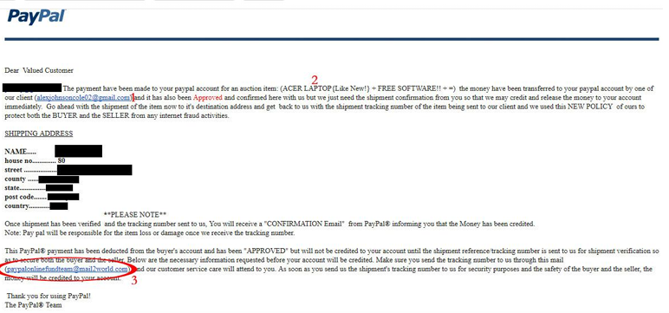
Real-World Example 3 — PayPal & eBay Scams

Slide 11
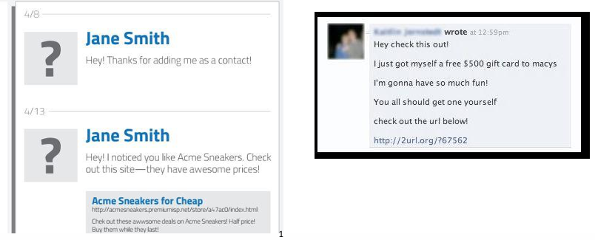
Real-World Example 4 — Social Media Traps
Tactics Used:
Scanned Likes: Criminals scan your profile for "likes" (e.g., Acme Sneakers) and send a message with a link to fake deals.
Identity Theft: Clicking these links often leads to a fake login page designed to steal your profile credentials to spread more phishing to your friends.

Slide 12
Best Practices for Protection
Passwords: I.T. will NEVER ask for your password over email.
Attachments: Be cautious even if you know the sender; call them to verify unexpected PDFs or files.
Web Safety: Look for https:// and a lock icon in the address bar before entering private data.
Verification: If you receive a suspicious email at VSU, forward it to abuse@valdosta.edu for examination.

Slide 13
Recognizing Phone Scams
Red Flag Phrases: "You've been specially selected," "You've won big money," or "You have to make up your mind right away".
Safety Tips: Obtain the salesperson's full business identity and license number before transacting. Never pay a fee to recover money you have already lost these are "recovery" scams.

Slide 14
Phishing Awareness: The "Spot the Hook" Quiz
Question 1: The Urgent Upgrade
You receive an email from "Service" with the subject line "ACCOUNT UPGRADE!!". The message states your mailbox is being upgraded from 10 GB to 20 GB and you must click a link to "jimdo.com" to fill in your details.
What is the biggest red flag here?
A) The offer of more storage space.
B) The link leads to an external domain (jimdo.com) instead of the official valdosta.edu domain.
C) The email was sent on a Friday.

Slide 15
Answer: B
Professional organizations will host account updates on their own official domains. External sites are used to steal credentials.

Slide 16
Phishing Awareness: The "Spot the Hook" Quiz
Question 2: The Social Media "Friend"
A person named Jane Smith adds you on social media and immediately sends a message: "Hey! I noticed you like Acme Sneakers. Check out this site—they have awesome prices!" followed by a link.
What tactic is being used?
A) Spear Phishing.
B) Social Engineering.
C) Clone Phishing.

Slide 17
Answer: B
Cybercriminals scan your public profiles for your interests to send "crafted" messages that look legitimate to trick you into clicking.

Slide 18
Phishing Awareness: The "Spot the Hook" Quiz
Question 3: The Telephone "Confirmation"
You receive a phone call from someone claiming to be from your bank. They ask you to "confirm" your credit card number and expiration date to protect your account from a "recent security breach".
How should you respond?
A) Provide the information immediately to secure your account.
B) Give them a false number to see if they notice.
C) Hang up and call your bank’s official number found on your statement or the back of your card.

Slide 19
Answer: C
This is "Vishing" (Voice Phishing). You should never give or "confirm" private information to an unknown caller.

Slide 20
Phishing Awareness: The "Spot the Hook" Quiz
Question 4: True or False?
The I.T. department may occasionally ask for your password via email if there is a major system emergency.
True
False

Slide 21
Answer: False
I.T. will NEVER ask for your password over email. Be wary of any request for private login data.

